Slide 1

Time Series Analysis of COVID-19 for the United States and North Carolina
Brandon Croom
Notes:
The human and business impact of the COVID-19 pandemic continues to unfold globally.
The rapid pace at which the pandemic is spreading is having an unprecedented impact on the way we live and do business.
While it is too early to fully understand the impact of these events, the goal of this project will be to analyze what the future in might look like in the post pandemic world.
This analysis will hopefully assist Gov. Roy Cooper and Dr. Mandy Cohen (NCDHHS head)

Slide 2

Agenda
Introduction
Positivity Rate
Data Set Information
Modeling Approaches
US Models
Univariate
Multivariate
NC Models
Univariate
Multivariate
Notes:
The following will be the agenda for this presentation. We’ll start with a quick discussion on positivity rate, look at the data set, discuss US Models and NC Models

Slide 3
Positivity Rate
Percentage of all coronavirus tests performed that are positive
Point in time-based metric
High values indicate high infection rate or low testing rate
Low values indicate low level of transmission
Viewed as exposure risk
Notes:
Beginning the analysis, evaluating the positivity rate a metric that is often cited in discussions of the state of the pandemic and in pandemic policy making. The positivity rate is defined as the percentage of all coronavirus tests performed that are positive.
Positivity rate is a point in time-based metric. Thus a location can go from high to low (or low to high) depending upon virus transmission or testing availability.
This metric can be someone confusing to individuals as a high value indicates a higher infection rate (or lower rate of testing) while a low value indicates the level of transmission, relative to testing, is low at this point in time.
Reference: https://www.jhsph.edu/covid-19/articles/covid-19-testing-understanding-the-percent-positive.html#:~:text=The%20percent%20positive%20is%20exactly,total%20tests)%20x%20100%25.
Given the velocity with which the pandemic and data reporting has been changing over the course of the pandemic, a point in time metric such as this is probably the best way to make decisions. Continued education to individuals when discussing this metric is required. This metric is not as simple to understand as a metric such as active cases or deaths.

Slide 4
Data Set Information
COVID19US – R-Package
Information on testing
COVDATA – R-Package
Information on Hospitalization Rates
Minimal missing data
Current as of 11/25/2020
Latest date COVDATA is updated
Notes:
Two R packages were leveraged to acquire COVID information. The COVID19US package sources testing information from the COVID19 Tracking project’s Application Programming Interface (API). The COVID19 Tracking project information is updated daily and is manually curated by volunteers to ensure accuracy. Data is at the state level and each state is graded on data accuracy. Hospitalization information came from the COVDATA R-package, which leverages various sources to obtain hospital information. Both sources data are relatively clean. Data is current as of 11/25/2020 which is the latest date the COVDATA package was updated.

Slide 5
Modeling Approaches
Univariate Analysis
ARIMA
Multi-Layer Perceptron (MLP)
Multivariate Analysis
VAR
Multi-Layer Perceptron (MLP)
Notes:
For Univariate Analysis ARIMA modeling was leveraged. Additionally, multi-layer perceptron MLP modeling was used. This is a type of neural network model that allows for multiple input layers to be connected to a number of hidden layers to produce an output.
For Multivariate analysis VAR modeling was leveraged. VAR modeling treats independent and dependent variables the same and thus allows for modeling any interaction between the terms. MLP modeling was also performed for the multivariate analysis.

Slide 6
Agenda
Introduction
Positivity Rate
Data Set Information
Modeling Approaches
US Models
Univariate
Multivariate
NC Models
Univariate
Multivariate
Notes:
The following will be the agenda for this presentation. We’ll start with a quick discussion on positivity rate, look at the data set, discuss US Models and NC Models

Slide 7
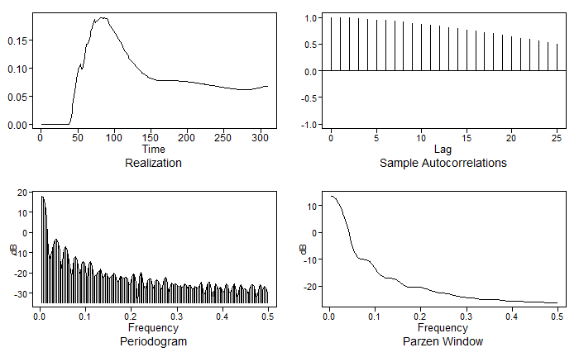
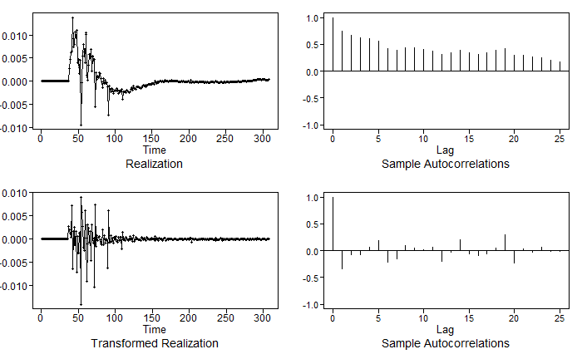
United States Analysis
Notes:
Evaluating the US data, the realization (in the upper left) shows how positivity rate has progressed over time. There is not any noticeable wandering or cyclic behavior in the data that can be visually inferred from this plot. The ACF plot (upper right) – seems to indicate slowly damping pattern which may indicate the data should be differenced due to non-stationarity.
The spectral density plot (lower right) – indicates a large peak at zero as well as other smaller peaks thoughout the display. This large peak at zero also helps support the need for differencing the data. After differencing the data twice we see that the data now looks stationary.

Slide 8
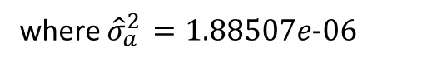
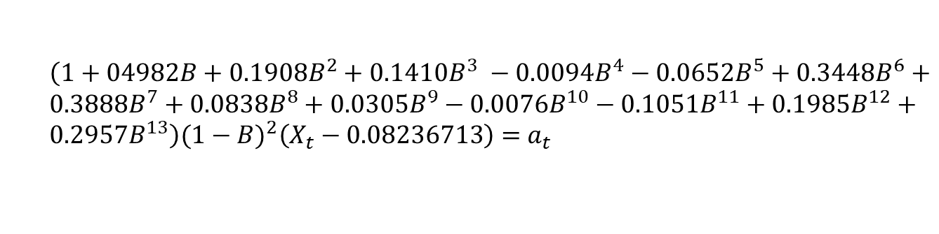
US ARIMA Model (Univariate Model)
Determined ARIMA(13,2,0) model, shown below, was best fit
AIC: 13.09
BIC: 12.92
$\left(1+04982B+0.1908B^{2}+0.1410B^{3} −0.0094B^{4}−0.0652B^{5}+0.3448B^{6}+0.3888B^{7}+0.0838B^{8}+0.0305B^{9}−0.0076B^{10}−0.1051B^{11}+0.1985B^{12}+0.2957B^{13}\right)(1−B)^{2}\left(X_{t}−0.08236713\right)=$ $a_{t}$
where ${\hat{σ}}_{a }^{2}=1.88507e-06$
Notes:
In order to build the ARIMA model, estimates for the AR and MA components the p and q parameters were estimated using AIC and BIC criteria. This approach assists in finding a less complex model if possible. Both AIC and BIC selected ARMA models with p=13 and q=0. The appropriateness of this model was further verified through residual evaluation both visually and through the Ljung-Box test.

Slide 9
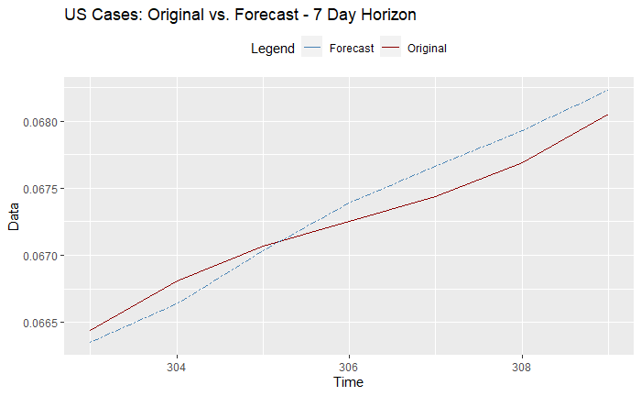
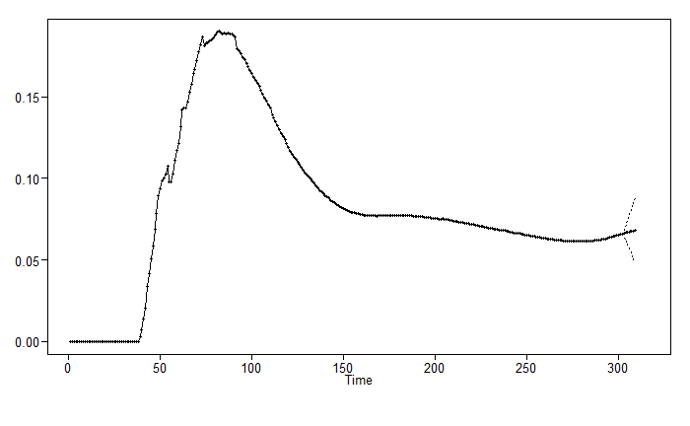
US ARIMA 7-Day Forecast (Univariate Model)
Notes:
The 7-day forecast for the US, given the size is difficult to view. Here we have blow into the last 25 observations so show the original and the forecast executions. From this graph we see that the forecast seems to be tracking well. There are times where the forecast is under and times where it is over, but not substantially either way

Slide 10
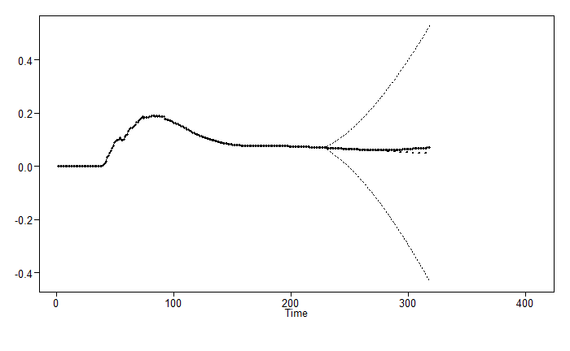
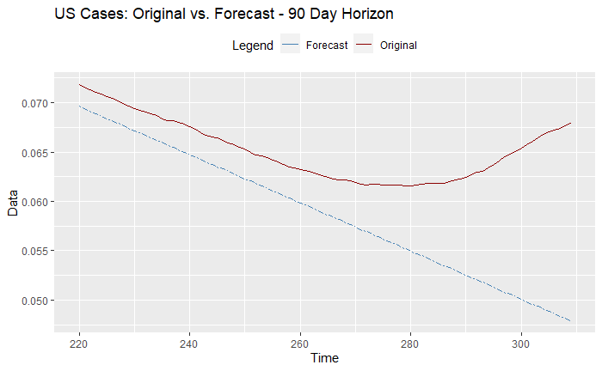
US ARIMA 90-Day Forecast (Univariate Model)
Notes:
The 90-day forecast for the US, given the size is difficult to view. Here we have blow into the last 25 observations so show the original and the forecast executions. From this graph we see that the forecast seems to be tracking well but continues on a downward slope while the real observations begin to trend upward.

Slide 11
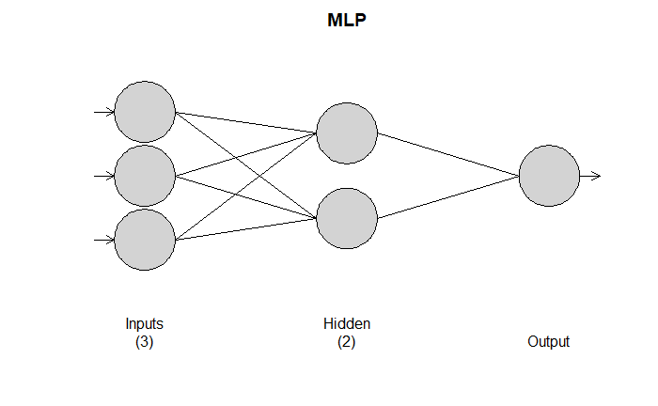
US MLP (Univariate Model)
Notes:
As previously noted, neural networks were leveraged as part of the analysis. For the Univariate US model a 3 input, 2 hidden layer network was selected.

Slide 12
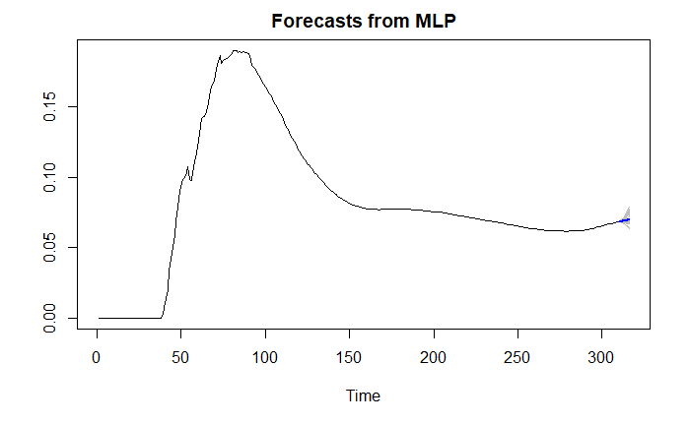
US MLP 7-Day Forecast (Univariate Model)
Notes:
The 7-day forecast MLP for the US, shows the mean model trend following the observation trends closely. There are a few models that go higher or lower, but the mean seems to follow the trend well.

Slide 13
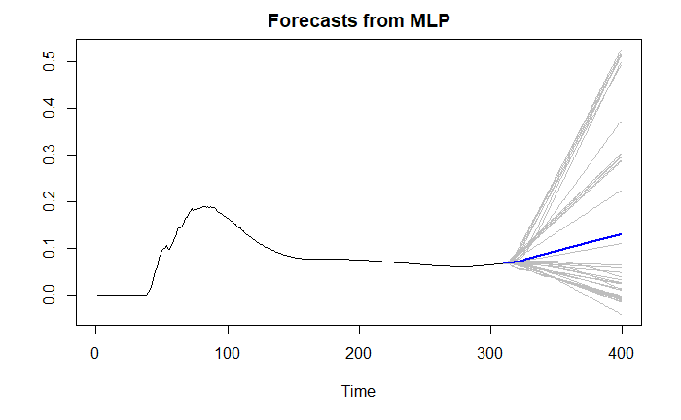
US MLP 90-Day Forecast (Univariate Model)
Notes:
The 90-day forecast MLP for the US, shows the mean model trend following the observation trends closely. There are a few models that go higher or lower, but the mean seems to follow the trend well. A differenced MLP model was also build, however the forecasts did not look as good as these.

Slide 14
Univariate Model Summary
Model Method | ASE – 7 Day Forecast | ASE – 90 Day Forecast
ARIMA(13,2,0) | 1.26780e-06 | 0.00173
MLP (d = 0) | 2.01956e-06 | 0.00053
MLP (d = 2) | 2.01956e-06 | 0.00053
Ensemble (ARIMA & MLP) | 1.37443e-05 | 0.00099
Notes:
The ASE metrics for each of the Univariate models is shown. The ARIMA model performed the best on the 7-day forecast while the MLP model performed best on the 90-day forecast.

Slide 15
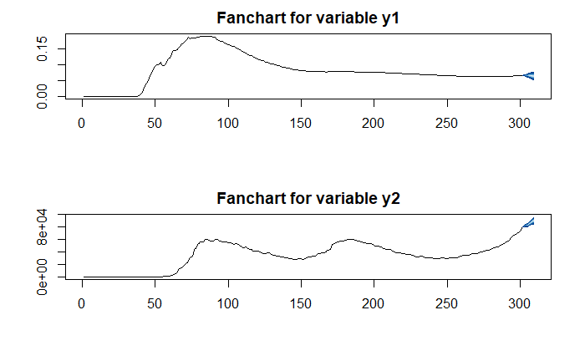
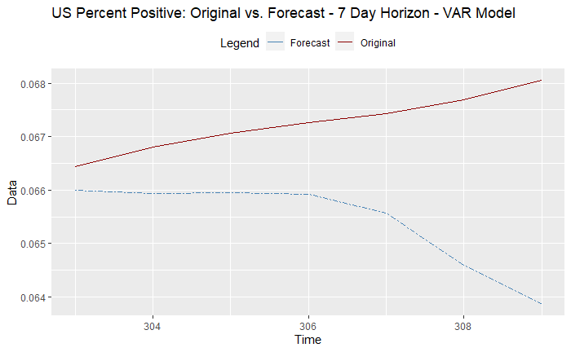
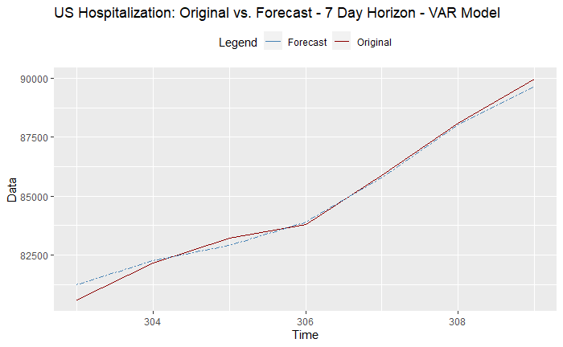
US VAR(15) 7-Day Forecast (Multivariate Model)
Notes:
Moving on the multivariate modeling, we’ll start with the VAR evaluation for the 7-day forecast. On the charts shown Y1 is positivity rate and Y2 is hospitalizations. From this view the forecasts seems to trend as expected.
Looking deeper at the Percent positive we see that the forecast doesn’t follow the observations well.
When evaluating hospitalization rate the forecast and original observations trend very close to each other.

Slide 16
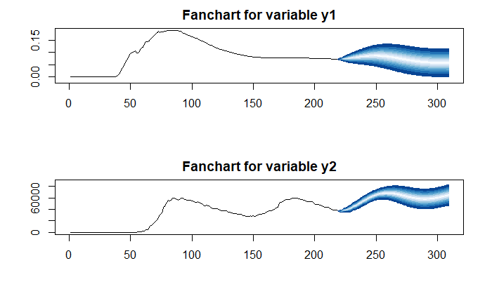
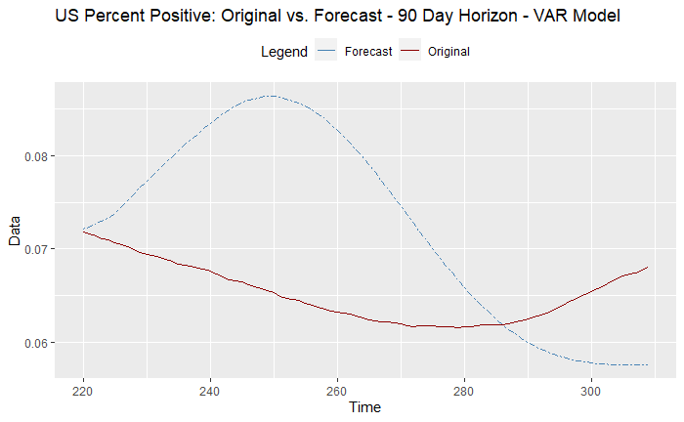
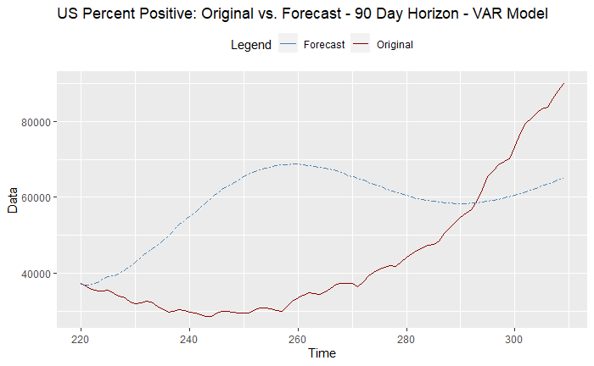
US VAR(15) 90-Day Forecast (Multivariate Model)
Notes:
Evaluating the VAR model for the 90-day forecast. On the charts shown Y1 is positivity rate and Y2 is hospitalizations. From this view the forecasts seems to trend as expected.
Looking deeper at the Percent positive we see that the forecast doesn’t follow the observations well.
When evaluating hospitalization rate the forecast and original observations trend is not close. Towards the end of the observation the forecast seems to follow better.

Slide 17
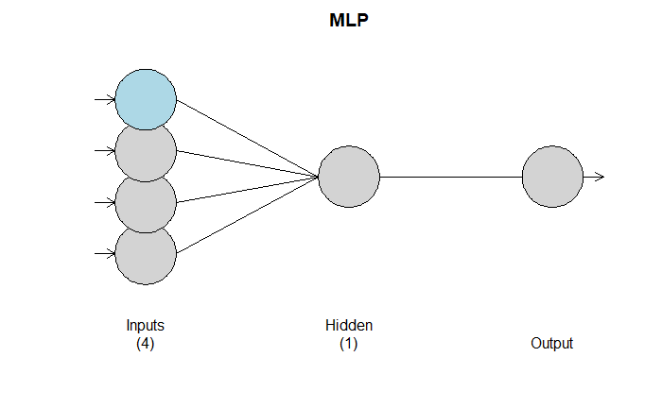
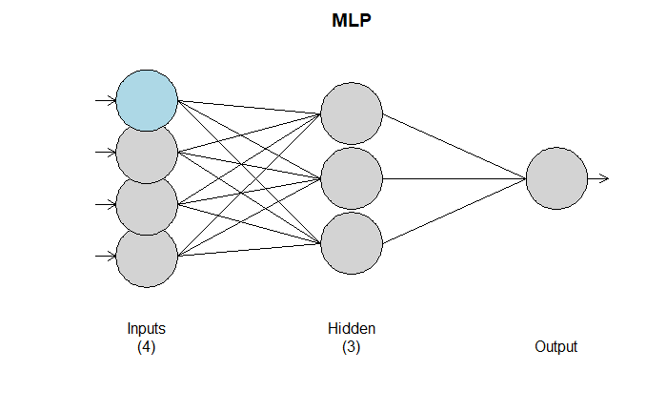
US MLP (Multivariate Model)
7-Day Forecast
90-Day Forecast
Notes:
As previously noted, neural networks were leveraged as part of the analysis. For the multivariate model, an MLP model for each forecast was developed. These models are shown on the screen.

Slide 18

US MLP 7-Day Forecast (Multivariate Model)
Notes:
The 7-day multivariate forecast MLP for the US, shows the mean model trend moving in a downward trend.

Slide 19
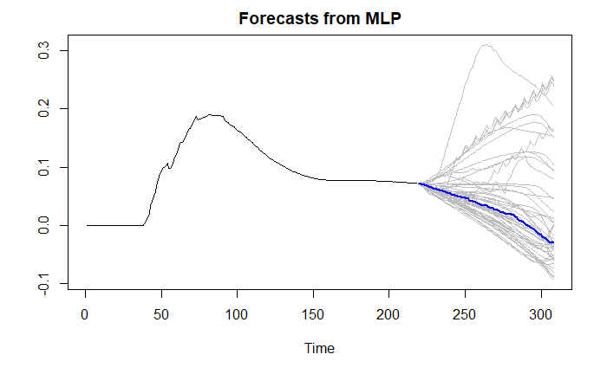
US MLP 90-Day Forecast (Multivariate Model)
Notes:
The 90-day multivariate forecast MLP for the US, shows the mean model trend following the observation trends closely. Again there is a downward mean slope to the forecast.

Slide 20
Multivariate Model Summary
Model Method | ASE – 7 Day Forecast | ASE – 90 Day Forecast
VAR(15) | 0.00010 | 2.6734e+35
MLP | 2.019568e-06 | 0.00053
Ensemble | 1.135600e-05 | 0.000512
Notes:
The ASE metrics for each of the Univariate models is shown. The MLP model performed best on the 7 day forecast and was slightly edged out by the Ensemble model.

Slide 21
Agenda
Introduction
Positivity Rate
Data Set Information
Modeling Approaches
US Models
Univariate
Multivariate
NC Models
Univariate
Multivariate
Notes:
The following will be the agenda for this presentation. We’ll start with a quick discussion on positivity rate, look at the data set, discuss US Models and NC Models

Slide 22
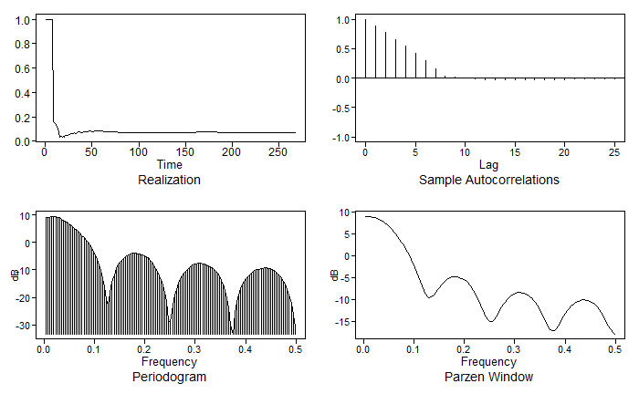
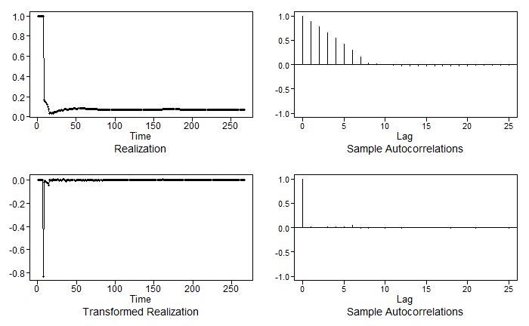
North Carolina (NC) Analysis
Notes:
Evaluating the North Carolina data, the realization (in the upper left) shows an immediate start at 100% and then a sharp drop in the positivity rate. In evaluating the data this drop is due to reporting of positivity rate. For the first 10 observations the positive cases and total number of tests were equal. It’s unknown if this is a data reporting error or true information. For the purposes of analysis it will be treated as true data. The ACF plot shows a quick step decline and the spectral density shows a large peak at zero with smaller peaks in the data. Given these indicators initially we will assume the data is non stationary. Differencing the data results in more stationary looking plots.

Slide 23

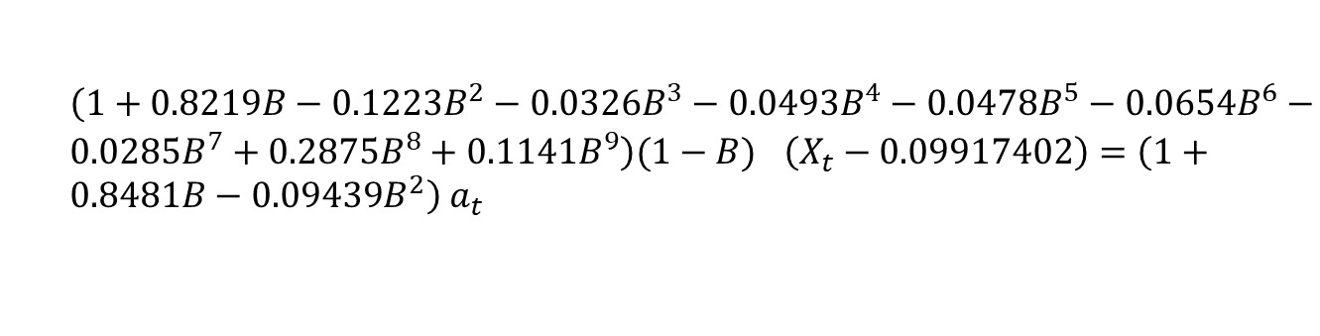
NC ARIMA Model (Univariate Model)
Determined ARIMA(9,1,2) model, shown below, was best fit
AIC: 6.038
$\left(1+0.8219B−0.1223B^{2}−0.0326B^{3}−0.0493B^{4}−0.0478B^{5}−0.0654B^{6}−0.0285B^{7}+0.2875B^{8}+0.1141B^{9}\right)(1−B)^{}\left(X_{t}−0.09917402\right)=\left(1+0.8481B−0.09439B^{2}\right)$ $a_{t}$
where ${\hat{σ}}_{a }^{2}=0.002179$
Notes:
After differencing the data, model estimates for the AR and MA components from both AIC and BIC were leveraged. There was no model selection agreement between the AIC and BIC for the data, thus for modeling the AIC selection of p=9 and q=2 was selected. The appropriateness of this model was further verified through residual evaluation both visually and through the Ljung-Box test. In both cases, the residuals indicated white noise. This indicates that the model should be appropriate.

Slide 24
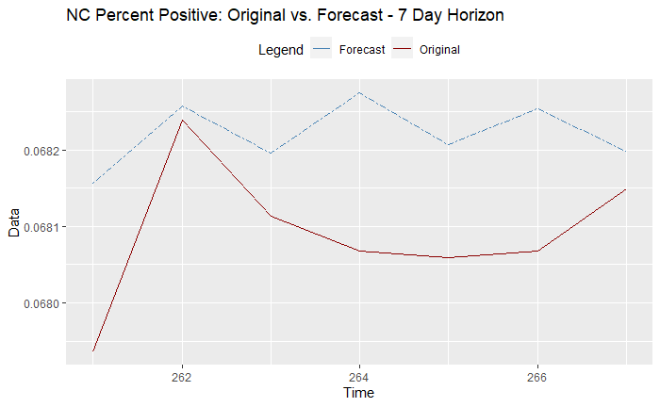
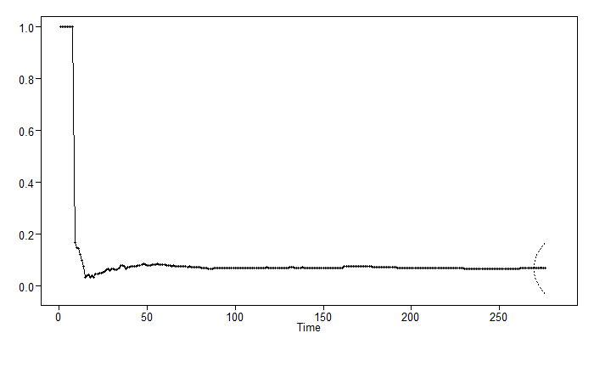
NC 7-Day Forecast (Univariate Model)
Notes:
The 7-day forecast for North Carolina, given the size is difficult to view. The confidence intervals are large which may indicate the forecast isn’t going to be as good. Here we have blown into the last set of observations we see that the forecast isn’t matching the observations very well.

Slide 25
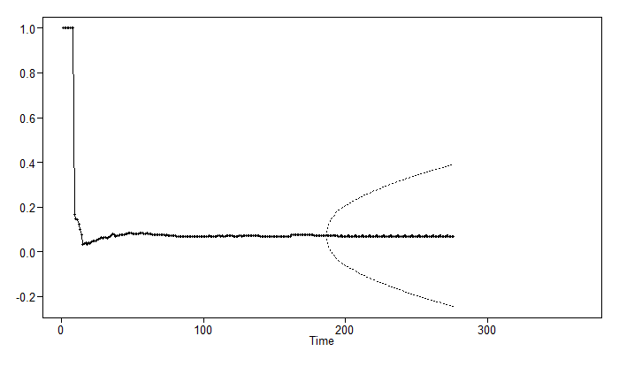
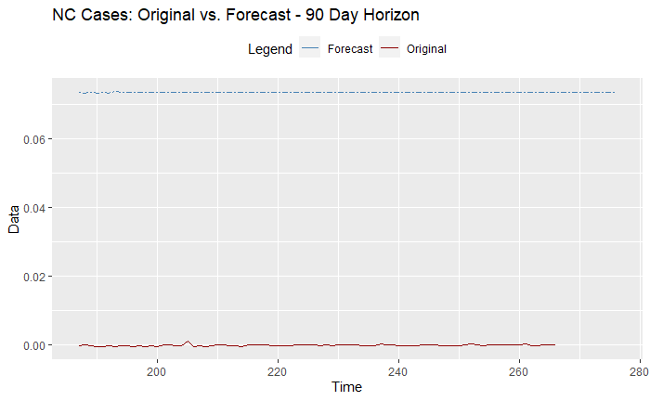
NC 90-Day Forecast (Univariate Model)
Notes:
The 90-day forecast for North Carolina, is viewable. As can be seen from the plot above the 90-day forecast simply levels out toward the mean of the data. Diving in to the observations shows a different story.

Slide 26
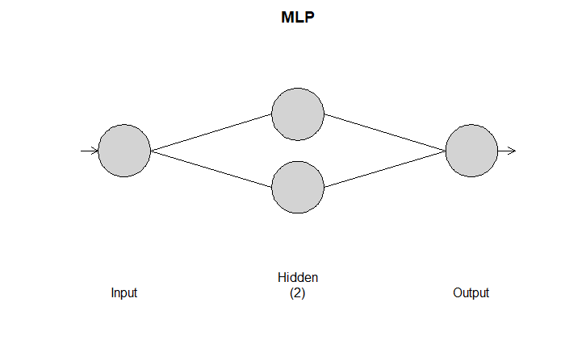
NC MLP (Univariate Model)
Notes:
As previously noted, neural networks were leveraged as part of the analysis. For the Univariate US model a 3 input, 2 hidden layer network was selected.

Slide 27
NC MLP 7-Day Forecast (Univariate Model)
Notes:
The 7-day forecast MLP for the US, shows the mean model trend following the observation trends closely. There are a few models that go higher or lower, but the mean seems to follow the trend well.

Slide 28
NC MLP 90-Day Forecast (Univariate Model)
Notes:
The 90-day forecast MLP for the US, shows the mean model trend following the observation trends closely. There are a few models that go higher or lower, but the mean seems to follow the trend well. A differenced MLP model was also build, however the forecasts did not look as good as these.

Slide 29
Univariate Model Summary
Model Method | ASE – 7 Day Forecast | ASE – 90 Day Forecast
ARIMA(9,1,2) | 1.95119e-06 | 0.000256
MLP (d = 0) | 1.717398e-06 | 1.30737e-05
MLP (d = 1) | 1.717398e-06 | 1.30737e-05
Ensemble (ARIMA & MLP) | 1.905830e-06 | 0.000332
Notes:
The ASE metrics for each of the Univariate models is shown. The ARIMA model performed the best on the 7-day forecast while the MLP model performed best on the 90-day forecast.

Slide 30
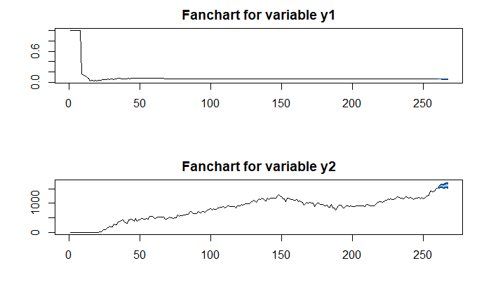
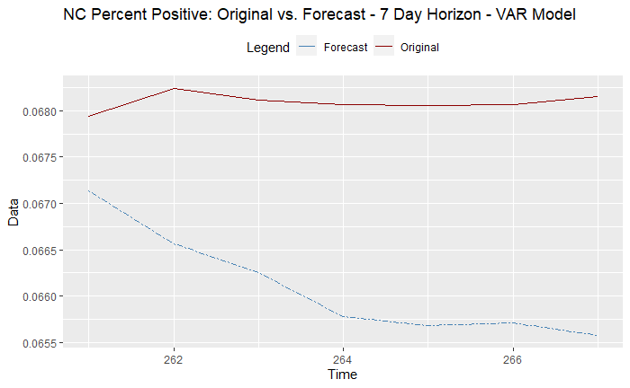
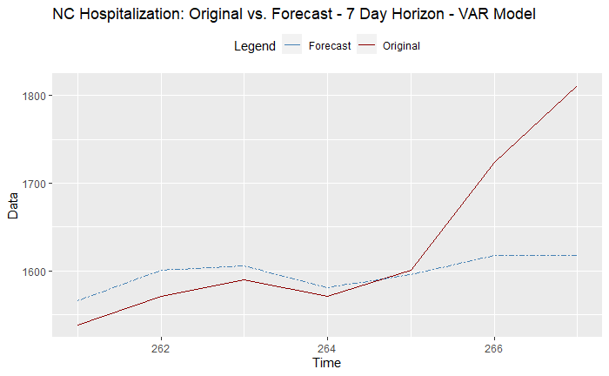
NC VAR(14) 7-Day Forecast (Multivariate Model)
Notes:
Moving on the multivariate modeling, we’ll start with the VAR evaluation for the 7-day forecast. On the charts shown Y1 is positivity rate and Y2 is hospitalizations. From this view the forecasts seems to trend as expected.
Looking deeper at the Percent positive we see that the forecast doesn’t follow the observations well.
When evaluating hospitalization rate the forecast and original observations trend very close to each other.

Slide 31
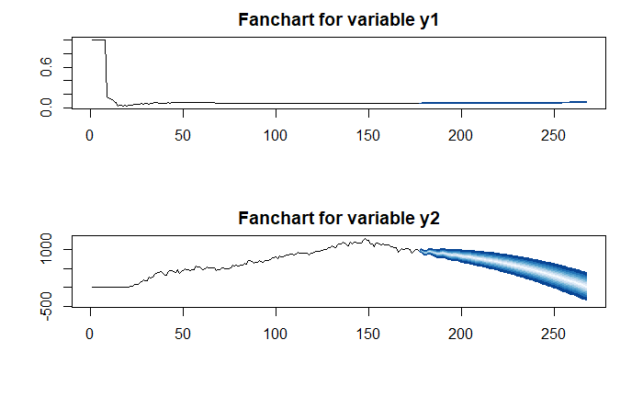
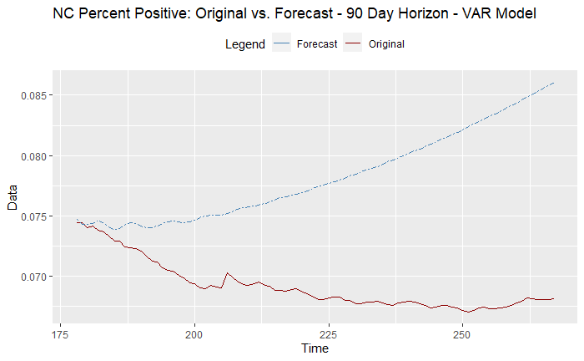
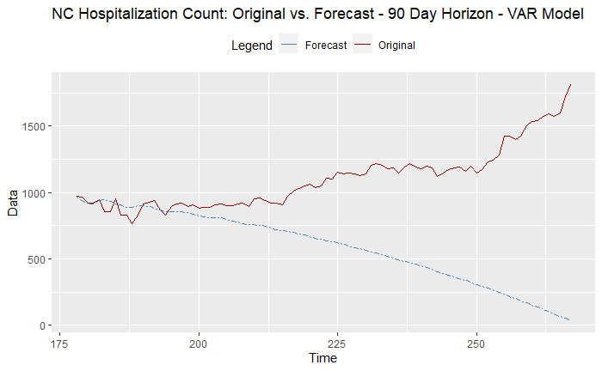
NC VAR(14) 90-Day Forecast (Multivariate Model)
Notes:
Evaluating the VAR model for the 90-day forecast. On the charts shown Y1 is positivity rate and Y2 is hospitalizations. From this view the forecasts seems to trend as expected.
Looking deeper at the Percent positive we see that the forecast doesn’t follow the observations well.
When evaluating hospitalization rate the forecast and original observations trend is not close. Towards the end of the observation the forecast seems to follow better.

Slide 32

NC MLP (Multivariate Model)
Notes:
As previously noted, neural networks were leveraged as part of the analysis. For the multivariate model, an MLP model for each forecast was developed. In the case of the North Carolina data the same MLP model was generated for both forecasts.

Slide 33
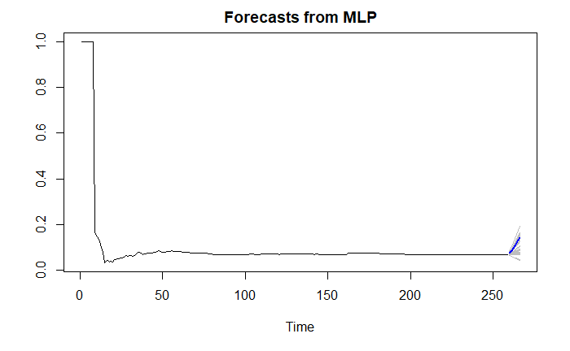
NC MLP 7-Day Forecast (Multivariate Model)
Notes:
The 7-day multivariate forecast MLP for the US, shows the mean model trend moving in a downward trend.

Slide 34
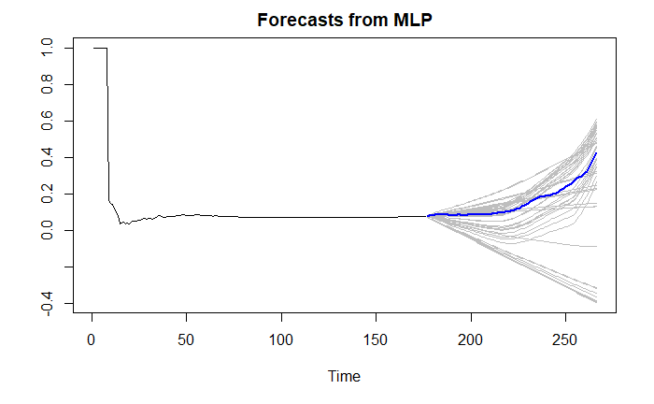
US MLP 90-Day Forecast (Multivariate Model)
Notes:
The 90-day multivariate forecast MLP for the US, shows the mean model trend following the observation trends closely. Again there is a downward mean slope to the forecast.

Slide 35
Multivariate Model Summary
Model Method | ASE – 7 Day Forecast | ASE – 90 Day Forecast
VAR(14) | 1.045971e-05 | 0.002931
MLP | 2.019568e-06 | 0.000530
Ensemble | 2.578109e-07 | 0.000517
Notes:
The ASE metrics for each of the Univariate models is shown. The MLP model performed best on the 7 day forecast and was slightly edged out by the Ensemble model.

Slide 36
Wrap Up
Multiple Time Series Models developed
MLP Models – best results
Future Enhancements
Additional external variables
Continued model refinement

Slide 37
Thank You.

Slide 38
References
Positivity Rate Articles
https://www.cnn.com/2020/11/17/health/covid-19-percent-positive-explainer/index.html
https://www.jhsph.edu/covid-19/articles/covid-19-testing-understanding-the-percent-positive.html#:~:text=The%20percent%20positive%20is%20exactly,total%20tests)%20x%20100%25
Data Set Information
COVID19US Package: https://cran.r-project.org/web/packages/covid19us/index.html
COVID Tracking Project API Package: https://covidtracking.com/data/api
COVID Tracking Project: https://covidtracking.com/

